Slide 1
Terrebonne Parish Recreation Modernization Board
Presentation to Terrebonne Parish Council
March 24, 2021

Slide 2
Board Members
District 1 – Joseph Boudreaux
District 2/3 – Joseph Teuton, III
District 4 – John Silver
District 5 – Elizabeth Dumez Rouen
District 6 – Dakota Fitch
District 7 – Kimberly Chauvin
District 8 – Monica Folse
District 9 – Edward Richard
District 10 – Shawny Marmande-Burgard
District 11 – Kevin Champagne
Business Community – Michael LaRussa
Business Community – Nicholas Hebert
Business Community – Brandon Boudreaux
Business Community – Sherri Roach
At-Large – Diana Collins
At-Large – Wilfred “PJ” Allridge, III
Advisory Board – Christopher Chiasson
Ad-Hoc – Erica Lambert

Slide 3
“Change is the law of life and those who look only to the past or present are certain to miss the future.”
- John F. Kennedy

Slide 4
The Current System
1956
First Recreation District formed was District 6 in 1956
July 1981
In July 1981, Terrebonne Parish Government is Consolidated
12 Aug. 1992
On August 12, 1992, Recreation District 11 was created.
1995
In 1995, the Council was reduced from 15 to 9 members.
23 Feb. 2018
On February 23, 2018, the Louisiana Attorney General’s Office issues Opinion 17-0121 confirming TPCG’s broad powers over Terrebonne Parish’s recreation districts.

Slide 5
Roles and Responsibilities Under Our Current System
TPR
Recreation Districts
To plan, host, schedule and coordinate recreation, quality of life and leisure activities for the residents of Terrebonne Parish.
To maintain certain recreational facilities and playgrounds that are owned or managed by Terrebonne Parish.
To build, maintain and operate recreational facilities throughout their respective districts.
To provide programs that TPR does not offer or that are not in direct competition with TPR.

Slide 6
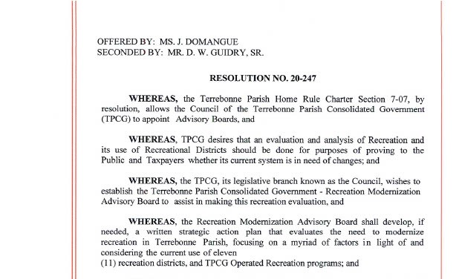
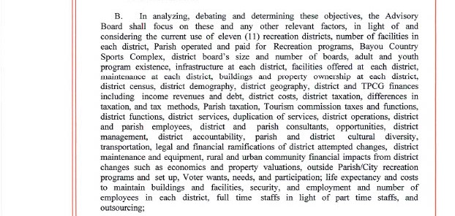
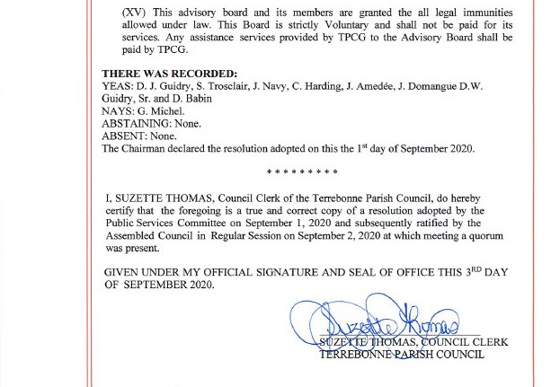
Resolution No. 20-247
Section A
Alter existing boundaries
Merge districts
Complete consolidation
Any other recommendations
Voter presentation
Section B
TPR programming
TPR operations
District operations

Slide 7
Total Consolidation, Moving of Lines and Merging of Districts

Slide 8
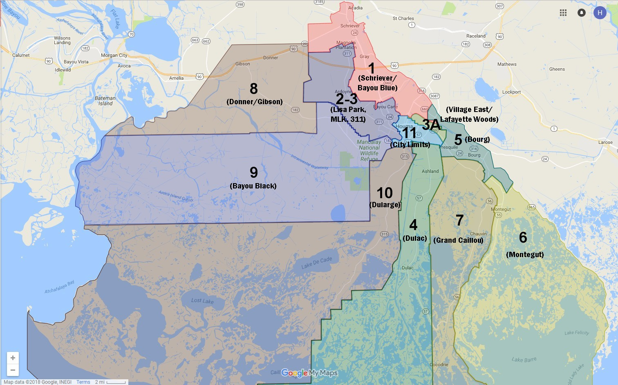
Map Overview of Recreation Districts

Slide 9
Consideration: Total Consolidation of All Districts
Things the Board Considered:
Facility usage is different in the bayou communities.
Minimal cross-district usage in the bayou communities.
Assessed values are rising in the Northern part of the Parish and falling in the Southern part.
Homestead exemption rates and millage rates differ drastically across the Parish.
Board Recommendation:
Not to Consolidate All of the Recreation Districts

Slide 10
Consideration: Merging of Districts
Things the Board Considered:
Financially predictable outcomes
Difficult to evaluate bond debt refinance options
Focused on districts with high cross-district usage that share borders
Focused on preparing for future development and growth
Assumed consistent operational expenses
Cognizant of millage rates and homestead exemption rates

Slide 11
Scenarios Evaluated
Merging Districts 1 & 2/3
Merging Districts 1, 2/3 & 9
Boundaries would encompass nearly 50,000 residents
Revenue neutral millage rate would be 5.75 mills
Rec 1 millage decrease of 1.25 mills
Rec 2/3 increase of 0.75 mills
Surplus Capital = $1.42MM
Boundaries would encompass nearly 56,000 residents
Revenue neutral millage rate would be 6.5 mills
Rec 1 millage decrease of 0.5 mills
Rec 2/3 increase of 1.5 mills
Rec 9 millage decrease of 8.2 mills
Surplus Capital = $1.42MM

Slide 12
Scenarios Evaluated
Merging Districts 2/3 & 9
Merging Districts 1, 2/3, 8 & 9
Boundaries would encompass over 35,000 residents
Revenue neutral millage rate would be 6.3 mills
Rec 2/3 millage increase of 1.3 mills
Rec 9 decrease of 8.47 mills
Surplus Capital = $1.06MM
Boundaries would encompass over 60,000 residents
Revenue neutral millage rate would be 6.7 mills
Rec 1 millage decrease of 0.3 mills
Rec 2/3 increase of 1.7 mills
Rec 9 millage decrease of 8.0 mills
Surplus Capital = $1.98MM

Slide 13
Board Recommendation: Merge Recreation Districts 1, 2/3, 8 & 9
Things the Board Considered:
What Does This Accomplish:
Financially predictable outcomes
Difficult to evaluate bond debt refinance options
Focused on districts with high cross-district usage that share borders
Focused on preparing for future development and growth
Gross Revenue > $4.2MM
Surplus Capital > $2.0MM
Merges over 60,000 residents under one common recreation district
Future plans and ideas can be planned across the total area

Slide 14
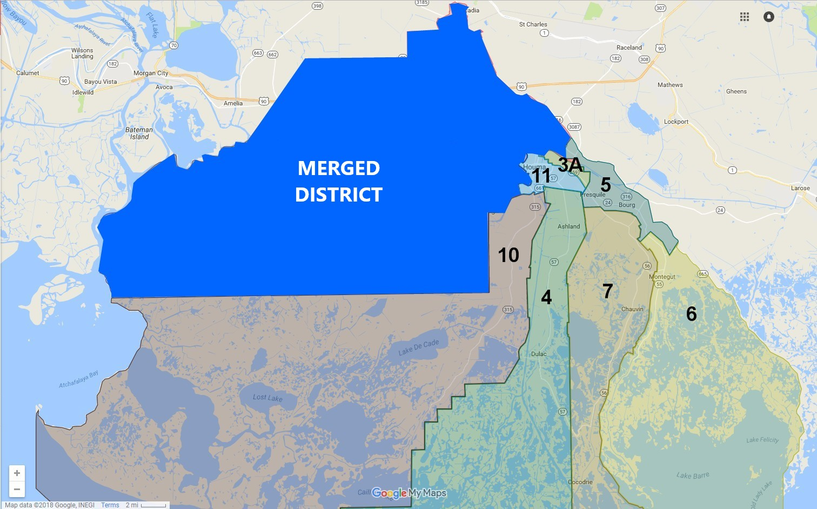
Map Overview of Recreation Districts

Slide 15
Recommendations on other Districts
Recreation District 11
Goal of 65-70% operating budget
Financial Analysis of Bond Debt
Evaluate the cost vs benefit of keeping and maintaining every facility
Airbase Park should be taken back by the Parish
Ensure all property in the district is paying a recreation millage; we found approximately $70,000 worth of new income
Recreation District 3A
Not advisable to merge at this time
Possible merge with Recreation District 11
Bayou Recreation Districts
Careful planning in the coming years
Explore more cooperative endeavor arrangements with each other

Slide 16
Board Efficiencies and Accountability

Slide 17
Standing Committee on Quality of Life
Present just like the other standing committees
Administration officials can report to Council
Budgets should be presented
5-year Plans should be presented
Reports on any issues regarding recreation districts

Slide 18
Accounting and Spending
Standardized Accounting Practices
Chart of Accounts
Financial Procedures
Costs Tracking by Asset
Reserve Requirements
Purchasing
Utilize Parish’s Purchasing Department
Coordinate large scale purchases or service orders

Slide 19
Board Efficiencies and Accountability
Policy Manuals
Human Resources
Standard Application for Employment
Updated HR policies addressing ethics, discrimination, etc.
Require completion of background checks and ethics training for board members
Risk Management
Establish insurance requirements
Utilize Parish insurance where available
Legal
Utilize Parish Attorneys
Standardize forms and agreements
Concessions
Rentals
Vendors
Hold Harmless

Slide 20
Concession Sales
All Sales
Valid Lease
Permits, Licenses and Insurances
District Operated
Cash Handling Policy
Separate Financials
Inventory Tracking
Sales Tracking
30-day Opt-out
For-Profit Vendor
% of Gross Sales
Presentation of Financials
Business Licenses

Slide 21
Non-Profit Concession Sales
District Related
Raise money for the whole district
Present financials and funds usage
Non-District Related
Raise money for teams, schools, etc.
Should be charged a fair rental rate
Should be rotational basis
Consider reducing or waiving rental rate

Slide 22
Planning and Capital Projects
Purchasing Property
Districts must notify the Council Clerk once authority has been given to negotiate/investigate land purchase.
Planning Projects
TPCG should adopt a set of standards for the development of recreation and quality of life facilities that are compatible with our area and applied uniformly.

Slide 23
5-Year Master Plan for each district
Presented annually with budget
All changes need to be presented to and accepted by Terrebonne Parish Council
Explore CEA’s for large purchases across multiple Districts
Evaluate options for surplusing underutilized assets
District Master Plans

Slide 24
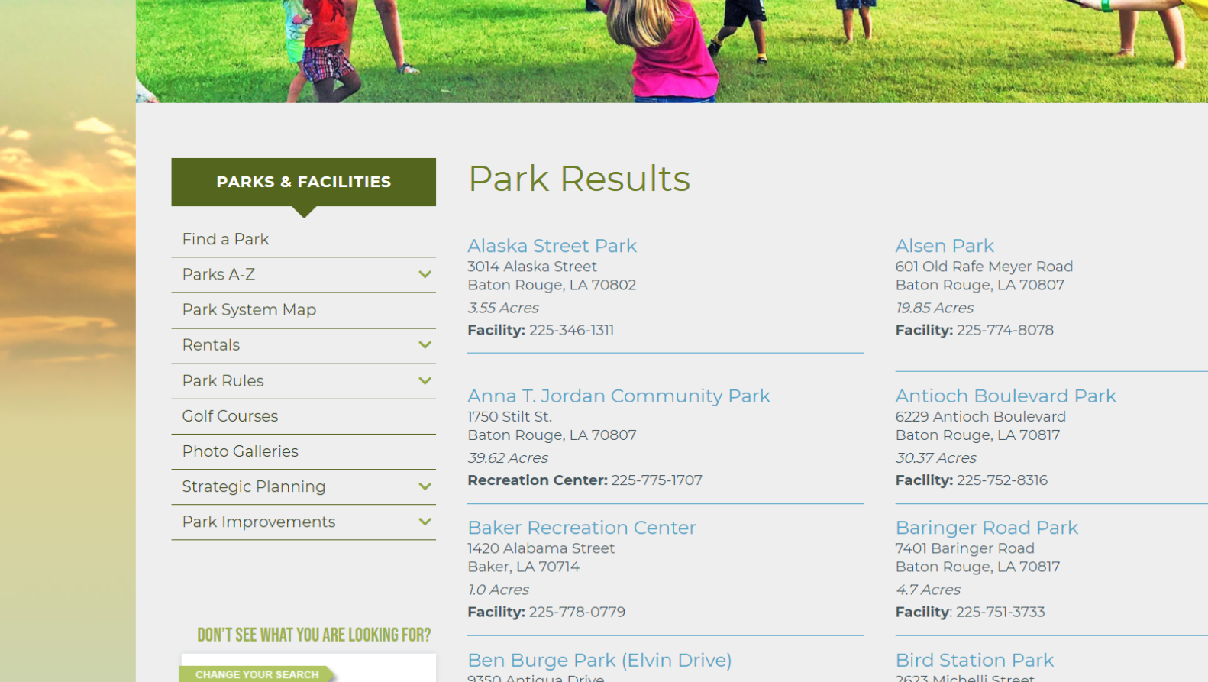
Master Assets List

Slide 25
Recreational Programming and TPR

Slide 26
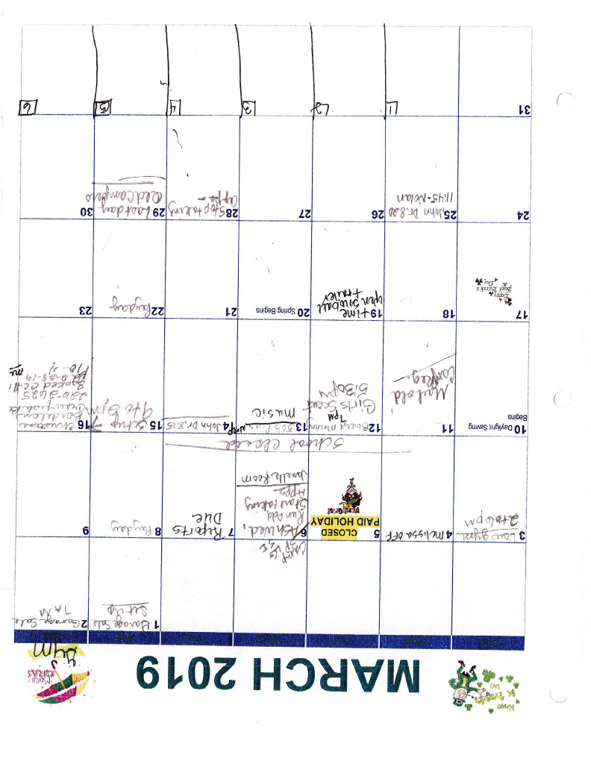
Scheduling, Scheduling, Scheduling…
Current Way of Scheduling
Largely done at the District Level
Paper Calendars
Telephone/Email Process
No Priority for TPR
Recommended Way of Scheduling
One Centralized Scheduling System for the entire system
TPR is given priority, up to a certain time

Slide 27
Registration
Current Registration
TPR has recently adopted an online registration process
Advertising is done via school flyers
TPR depends on coaches to relay information to parents and players
Cannot capture usage data
Recommended Registration
Contract with a third-party vendor for online registration
https://sportsconnect.com
https://recdesk.com
https://www.ezfacility.com
Manages all aspects of recreation
Easily communicate with coaches, parents and players via electronic media.
Recommended Registration
Contract with a third-party vendor for online registration
https://sportsconnect.com
https://recdesk.com
https://www.ezfacility.com
Manages all aspects of recreation
Easily communicate with coaches, parents and players via electronic media.

Slide 28
Recreational Programming and TPR
Participation
Continue working to recruit coaches and players from all areas of the Parish
Spread out the games and utilize more assets
Gym and Field Supervisors
TPR should provide employees for TPR-sponsored events
Rules and Policies for Sports
All sports offered by TPR should have rules and policies available online at all times
Fees, Uniforms and Equipment
Current fees are reasonable
TPR should look to upgrade uniforms
Create guidelines and policies for corporate sponsorships

Slide 29
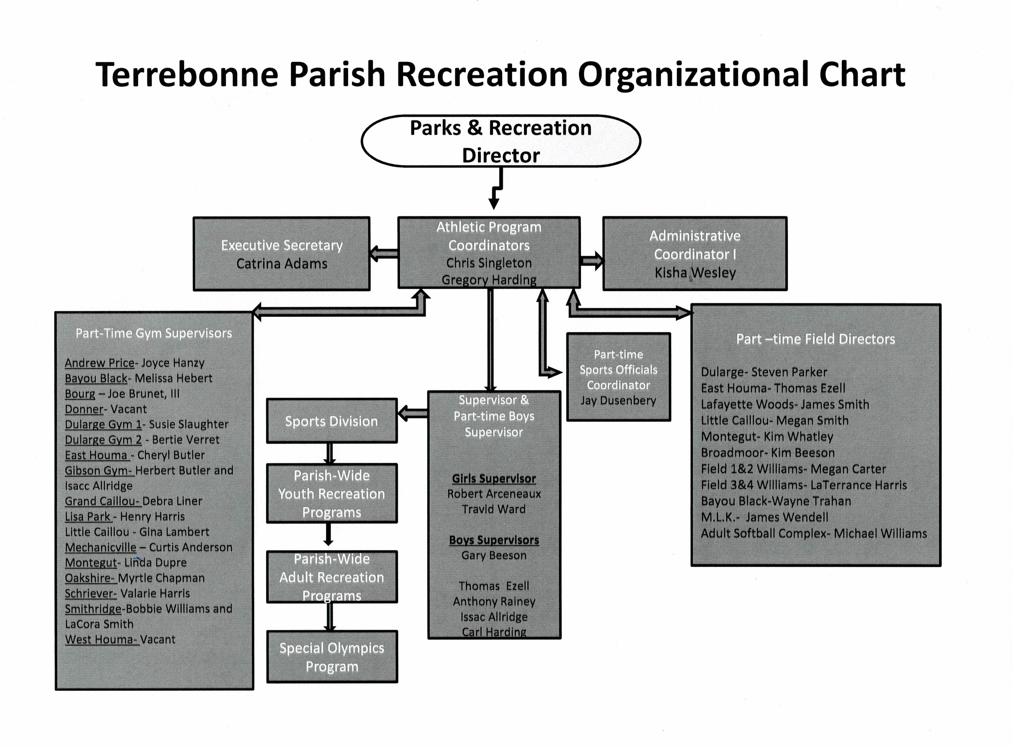
Organizational Chart
Difficulties in the Old Chart
Outdated
Overlapping positions
Lack of Consistency
Lack of Accountability
Benefits of the New Chart
Modernized
Accountability Throughout
Good Points of Contact for All Topics

Slide 30
Coaches and Officials’ Meetings
TPR should host two meetings with coaches and officials per sport
Discuss improvements, possible changes and overall successes and failures of the season
Bring in special guests to inspire and answer any questions

Slide 31
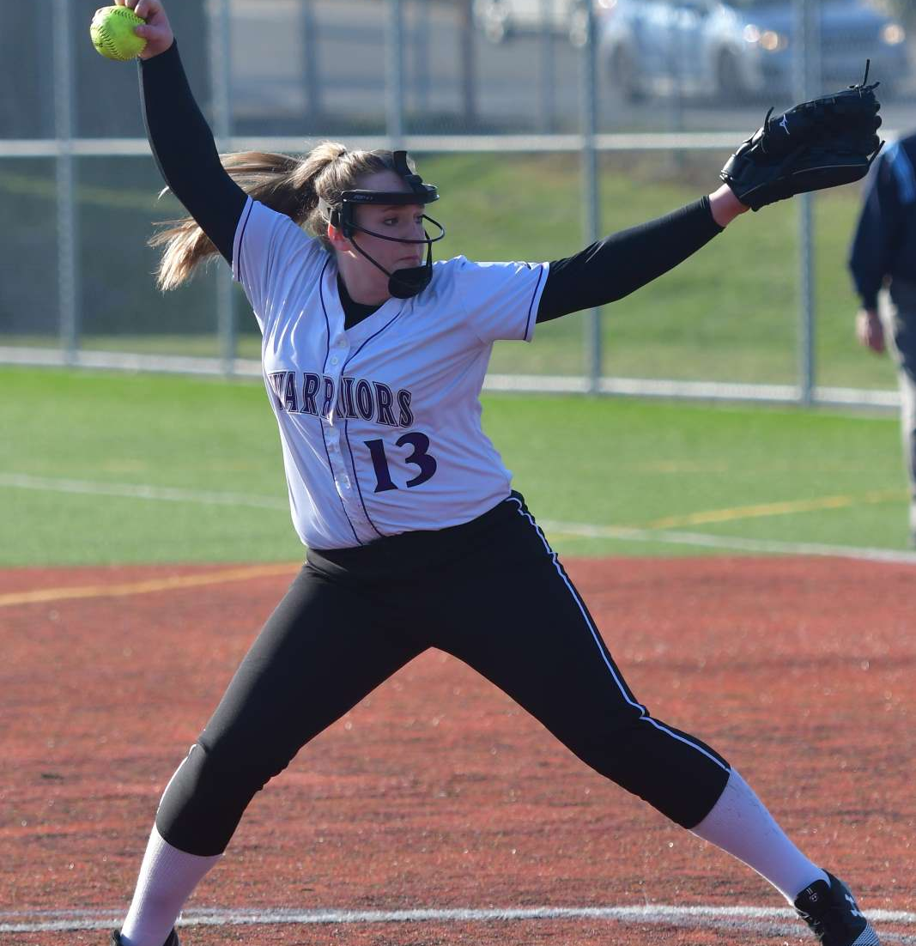
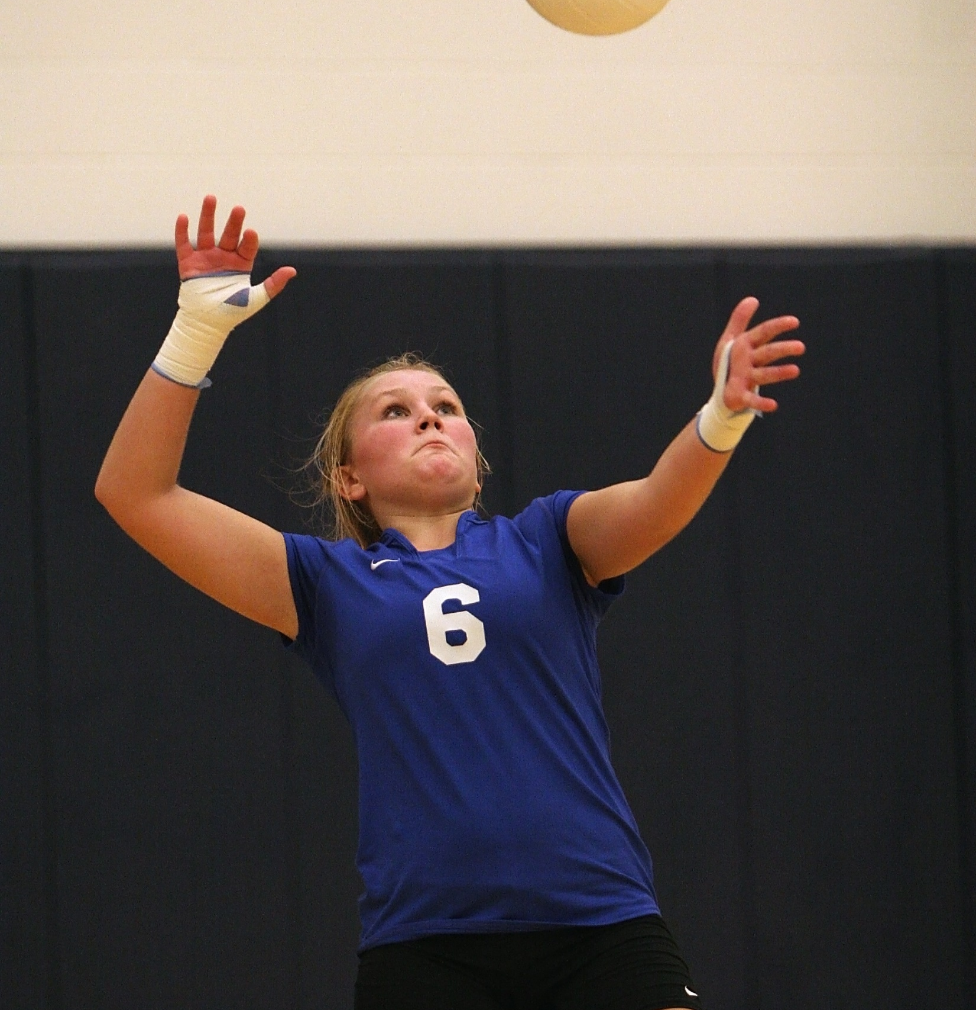
Individual Sport Recommendations
Baseball/Softball/Basketball/Volleyball
Create a workgroup for pilot competitive league
Focus on developing fundamentals

Slide 32
TPR Competitive League
Travel sports have changed the recreational league aspect of all sports.
Many travel teams enter traditional TPR leagues.
TPR should create a competitive league that offers a higher level of competition for those wanting it.
Start with the sports of baseball, softball, basketball and volleyball.
Coordinate with the stakeholders in those sports to develop the league.

Slide 33
Individual Sport Recommendations
Football
Now that TPR has created a flag football program, phase out 7-8 year-old contact football for safety reasons
Tennis
Continue working with current vendor
Evaluate options for facilities before building new
Soccer
Continue working with current vendor
Promote soccer on the East side of town
Lighted fields should be a priority as fields are multiple purpose

Slide 34
Individual Sport Recommendations
Swimming
Swimming community feels that Parish has enough pools
TPR should promote community swimming lessons
Running
Look into CEA’s with established running organizations
Will help expand the programs throughout the Parish

Slide 35
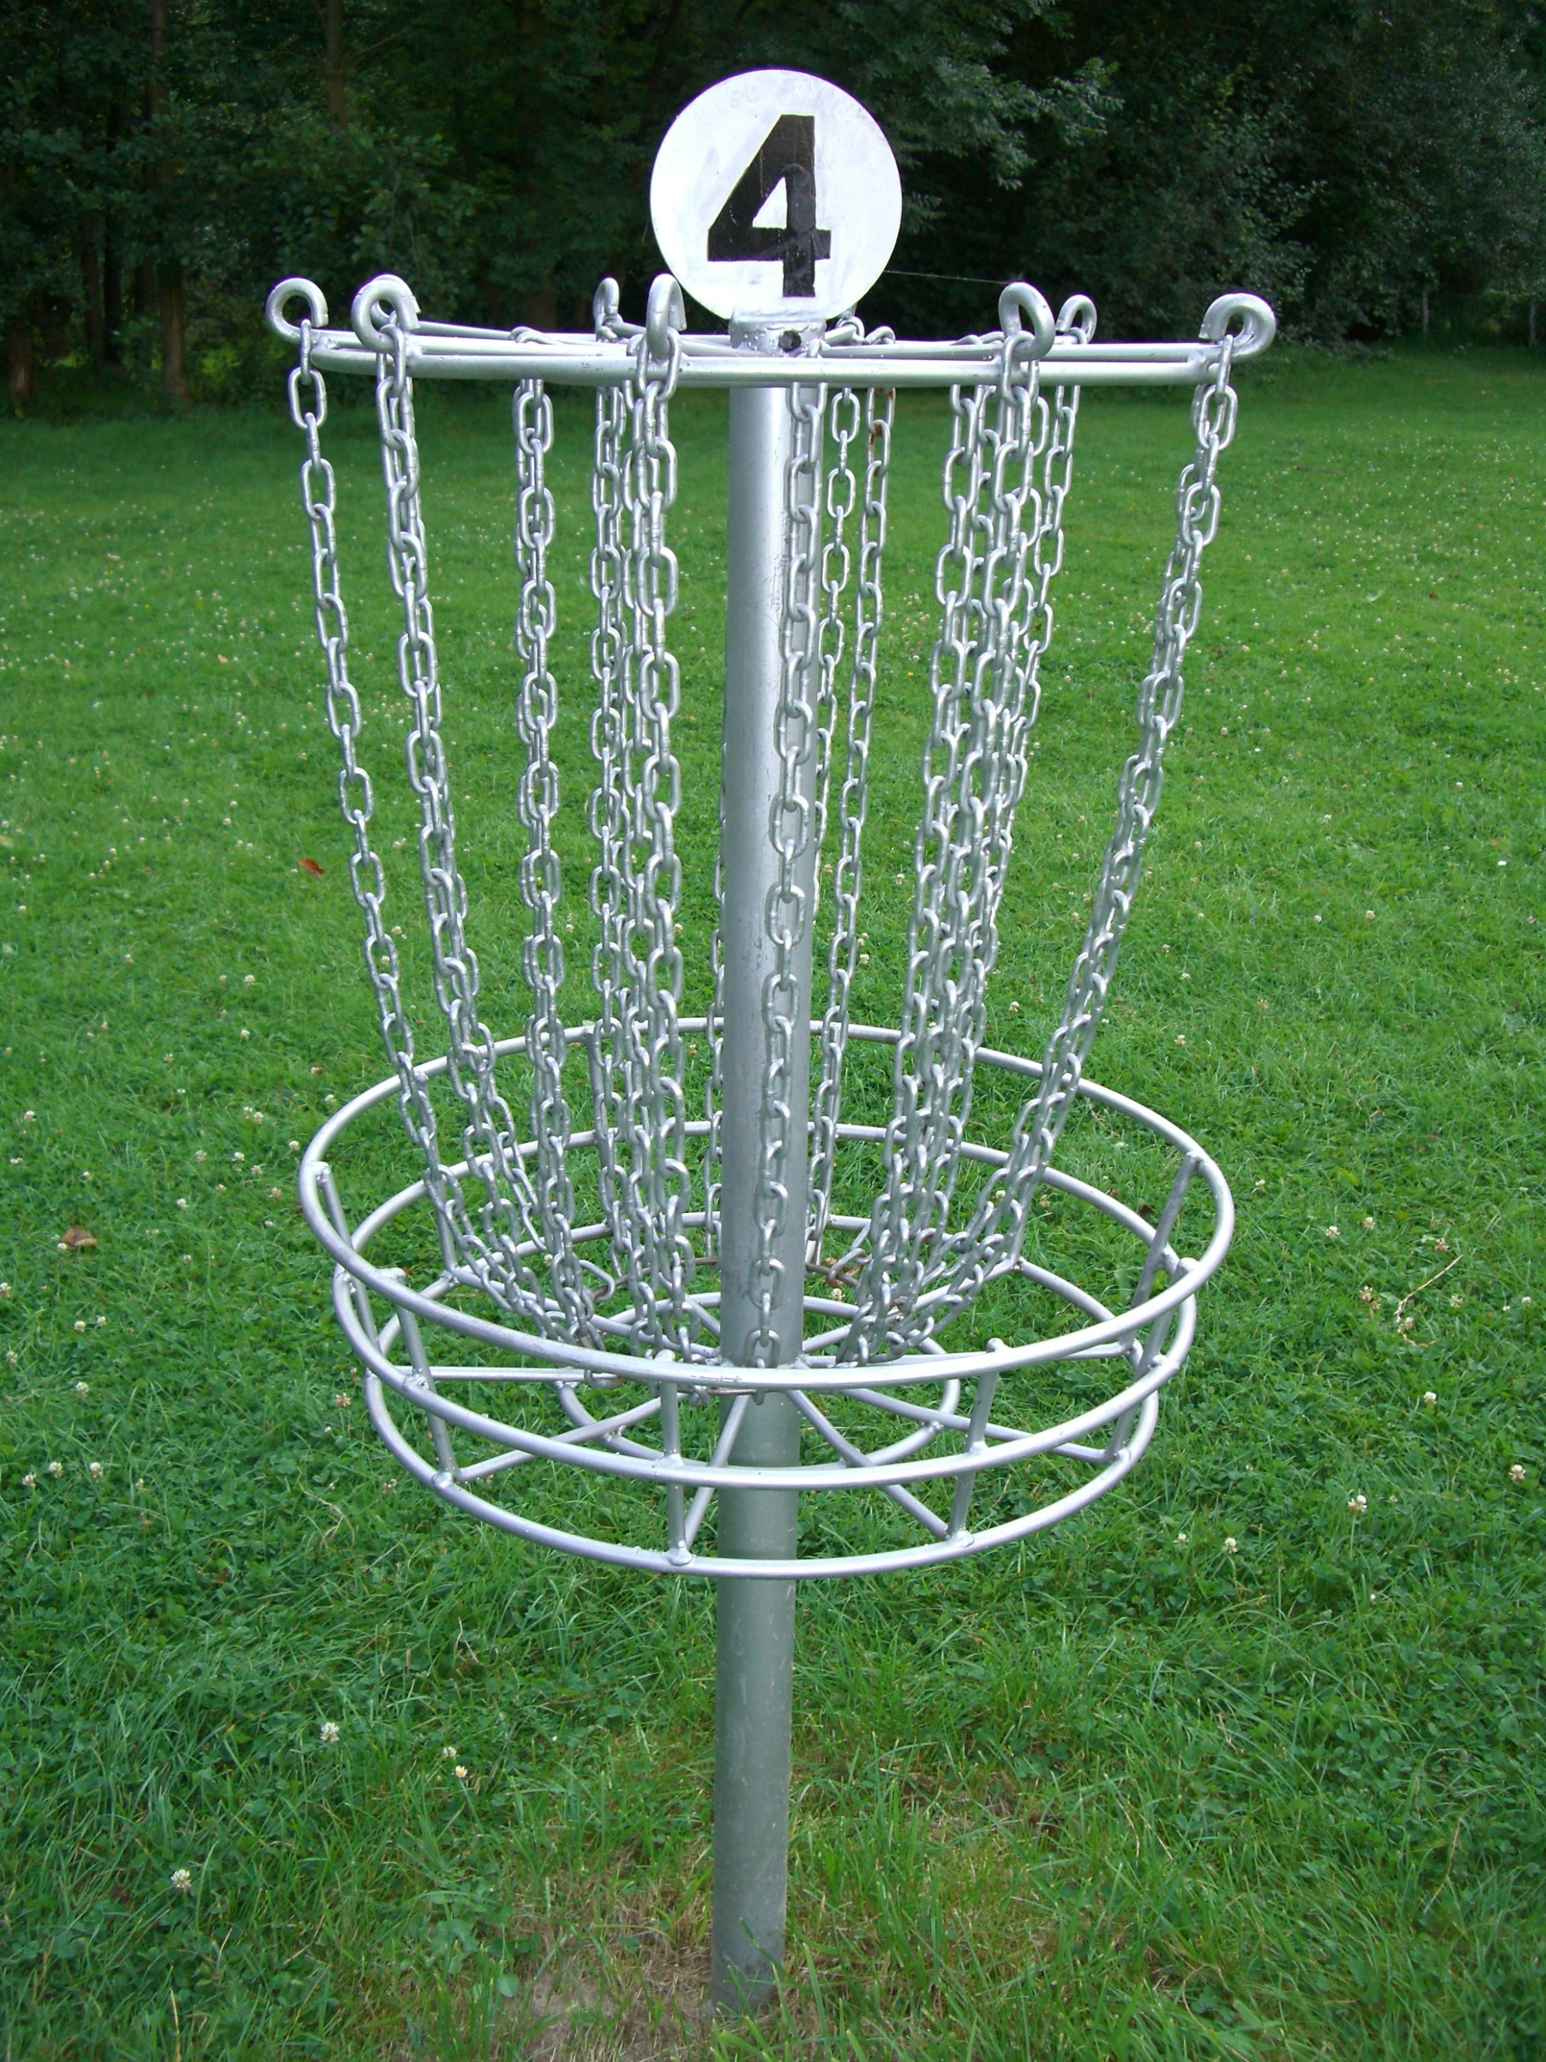
Beyond Traditional Sports
Alternative Recreation
1
Slow-pitch softball
Disc Golf
Kickball
Fishing
Partnerships with Arts Organizations to provide monthly arts and crafts classes
2
After School Programs and Summer Camps
3

Slide 36
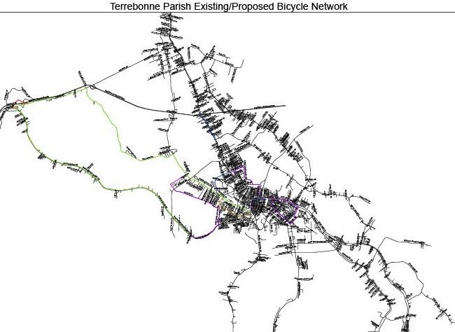
Trailways, Blueways & Fishing
Coordination between Districts and TPCG Planning to develop the regional Bicycle and Pedestrian Plan
Focus on interconnected systems
We are part of the South Central Regional Metropolitan Planning Organization that includes paddle trails, bike trails and walking trails throughout the area
Districts and TPR should promote fishing opportunities

Slide 37
Adult and Senior Recreation
Board Observations
Very little currently offered for these demographics
Facilities are often empty during the day
Several agencies and organizations are dedicated to various sectors of these demographics
Board Recommendations
Presents a tremendous opportunity for TPR
Pilot programs for pickle ball, corn hole, kickball, dodgeball, etc.
Provide senior programs during the day
Yoga, art classes, crossfit, etc.
Partner with outside organizations such as Council on Aging to offer more…meals, dances, etc.

Slide 38
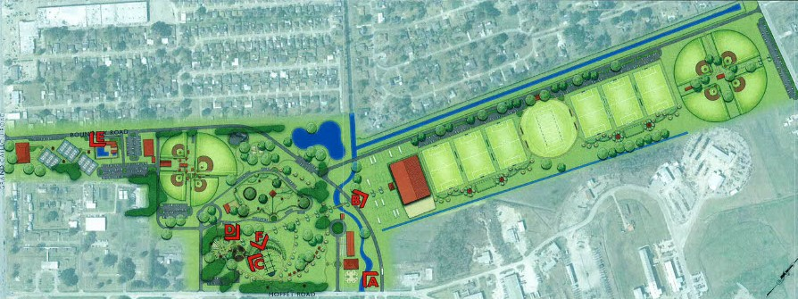
Airbase Complex
Complimentary facility to Bayou Country Sports Park
Financial burden on Rec District 11
No budgeted maintenance for new elements
Board Recommendation:
TPCG should take over control, planning and
maintenance of the Airbase Complex

Slide 39
Adaptive Sports and Recreation
Districts are adding all-accessible equipment to their parks, but care should be taken
Facilities are limited because of parking, loading and unloading locations
Summerfield All-Accessible Park was 1 of 7 in the entire state when constructed
What does ADA-compliant mean? What are its limitations?
What is Special Olympics? What it is not?

Slide 40
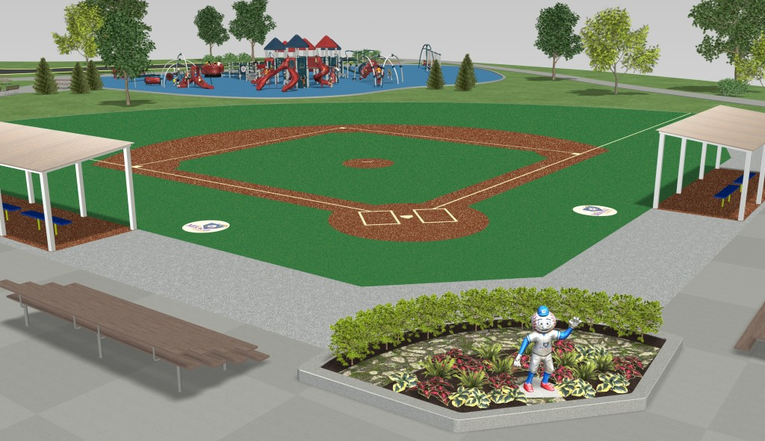
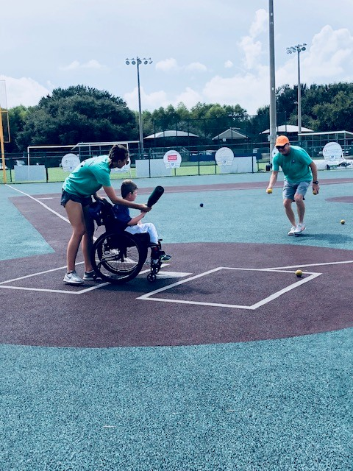
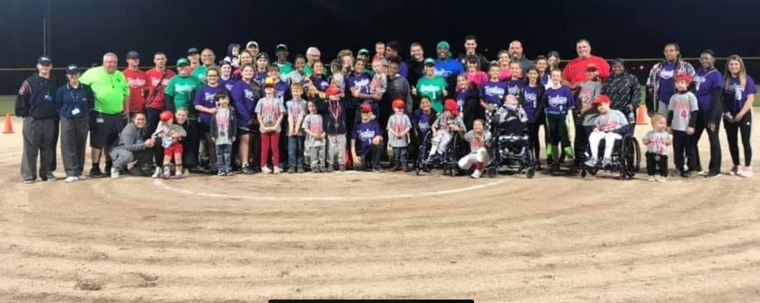
Bayou Buddies
What is this league? What does it offer?
Who is the “Buddy” in Bayou Buddies?
What does it need?
Where should it be?
Why should it be done?

Slide 41
“If you always do what you’ve always done, you’ll get what you’ve always got.”
- Henry Ford

